Slide 1






AI/ML in Power BI
Somy Ayazi – Microsoft AI MVP
Atlassian | @SomyAyazi | somy-ayazi​
Notes:
​

Slide 2




Who am I?
Engineering Manager with Atlassian
Co-hosting The Global AI Podcast @GlobalAIPodcast
APAC AI community co-organiser
Atlassian | @SomyAyazi | somy-ayazi​

Slide 3
AI and ML in Power BI

Slide 4

What is AI?
AI is the creation of software that imitates human behaviours and capabilities and the ability to interact intelligently with the user.​
Key element:​
Machine learning - The way we "teach" a computer model to make prediction and draw conclusions from data.​
Anomaly detection - The capability to automatically detect errors or unusual activity in a system.​
Computer vision - The capability of software to interpret the world visually through cameras, video, and images.​
Natural language processing - The capability for a computer to interpret written or spoken language and respond in kind.​
Conversational AI - The capability of a software "agent" to participate in a conversation

Slide 5
AI in Power BI
Detect Image contents
Detect Language
Sentiment analysis
Key phrase extraction
Supported Services

Slide 6

Detect Image Content
Application: Process large numbers of images and detecting the object on the image using computer vision.
Likely users: E-commers, internet services
Tech: Computer Vision within AI. Models are mostly classification algorithm
Challenges: Label are limited in numbers and lack a structure or taxonomy. Not all language are supported.

Slide 7

Detect Language
Application: Automatically detecting the language for a piece of text
Likely users: Content handlers (internet services, Academic, History, etc)
Tech: NLP
Challenges: Not available for all languages

Slide 8

Semantic Analysis
Application: useful for detecting positive and negative sentiment in social media, customer reviews, and discussion forums, etc.
Likely Users:
Marketing departments
Public Organizations
PR departments
Customer Service representatives
Engine: NLP, Azure cognitive services
Challenge: Required domain knowledge

Slide 9

Key Phrase Extraction
Application: Save time by automatically deriving the most relevant content from text, an article, social media feeds, survey results an interaction with customer support and many more
Likely Users:
Academic Researchers, Publishing industry
Marketing and PR departments
Intent services, Cyber security, Customer service
Engine: NLP, Azure cognitive services
Challenge: Required domain knowledge

Slide 10
Anomaly Detection
Q&A Visual
Smart Narrative Visual
Decomposition Tree
Key Influencer Visualization
Features

Slide 11
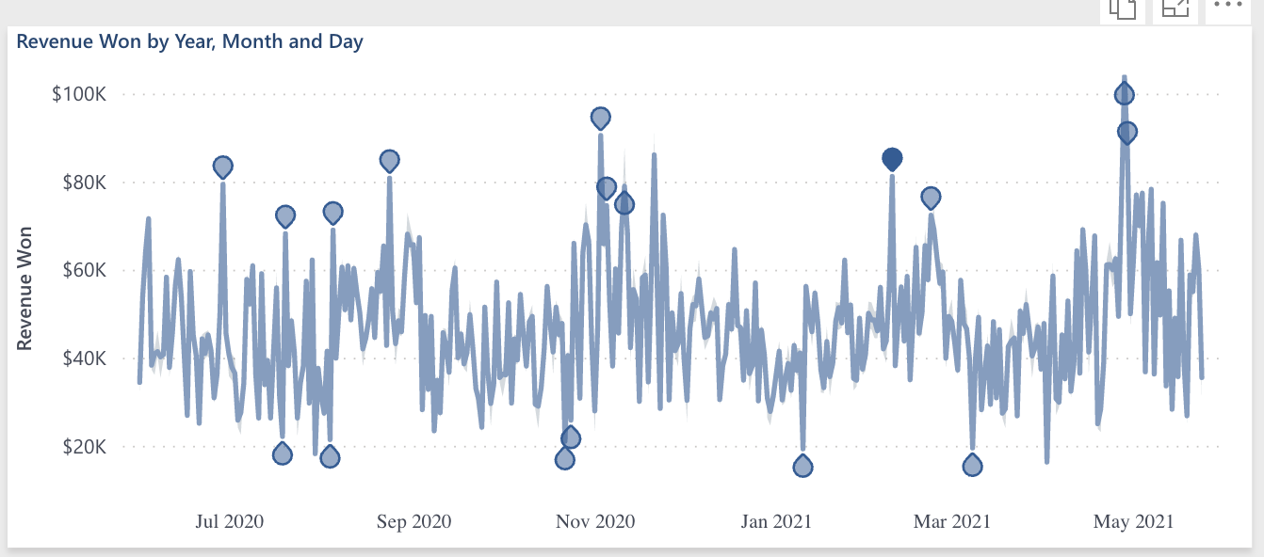
Anomaly Detection
Application: Automatically detect unusual data points, trend changes or other outliers.
Likely users: Banking, security, marketing, retail, etc.
Features

Slide 12
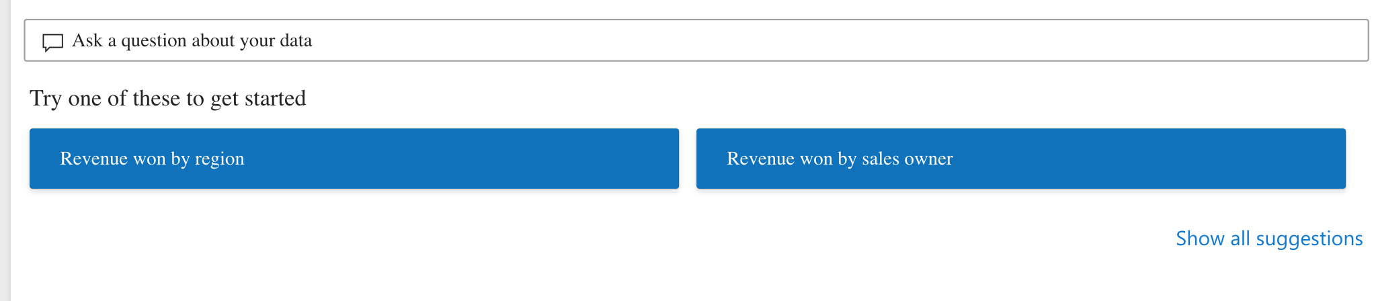
Q&A Visual
It allows users to ask Natural questions and get answers in the form of visuals. Consumers can use it to quickly get answers to their data. Designers can use it to create visual quickly.
Likely users: Sales, finances & HR document, marketing team
Tech: NLP
Features

Slide 13
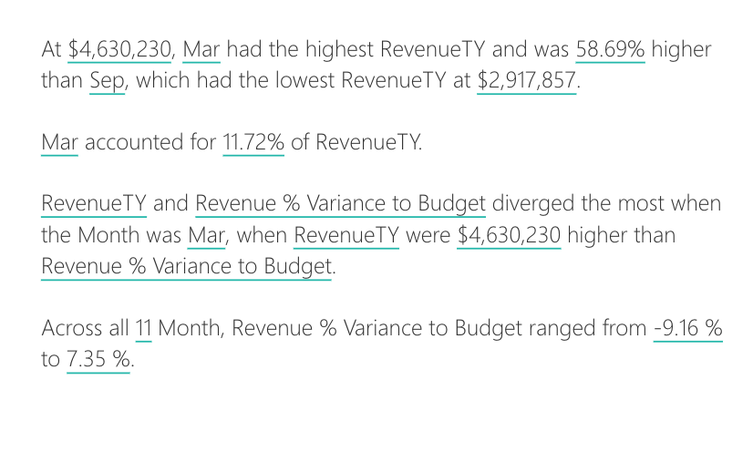
Smart Narrative Visual
Summarize the key takeaways from a visual.
Can be adjusted
Drill down capabilities
Seems to be using NLP and similar to Q&A
Features

Slide 14
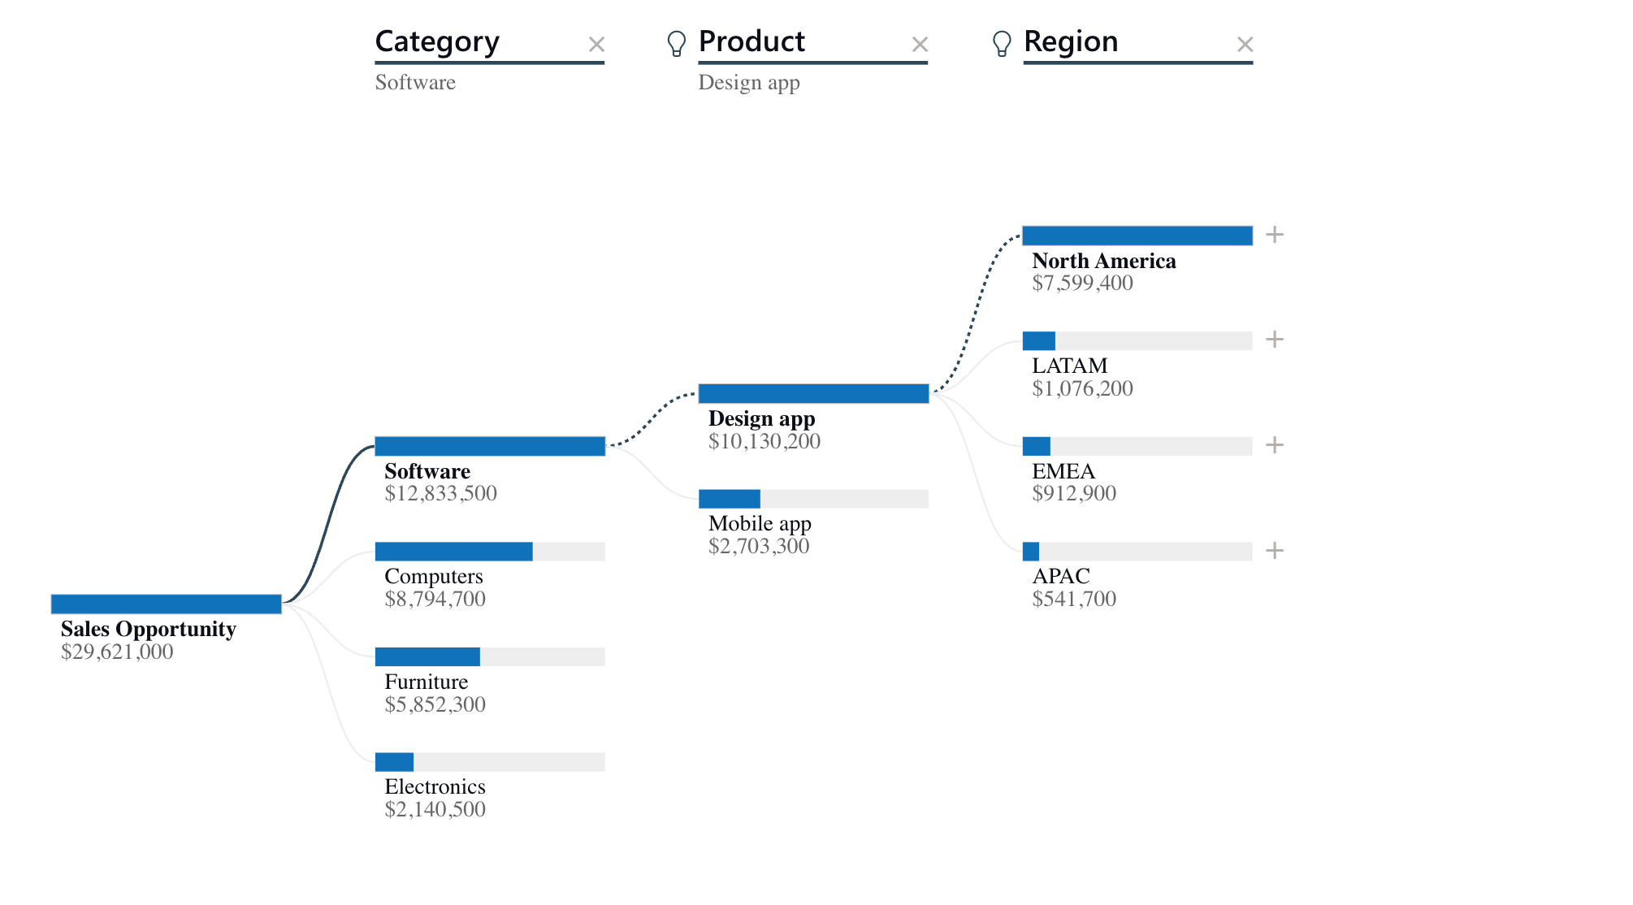
Decomposition Tree
The decomposition tree visual in Power BI lets you visualize data across multiple dimensions,
Automatically aggregate data and enables drilling down into
Valuable tool for ad hoc exploration and conducting root cause analysis.
Features

Slide 15
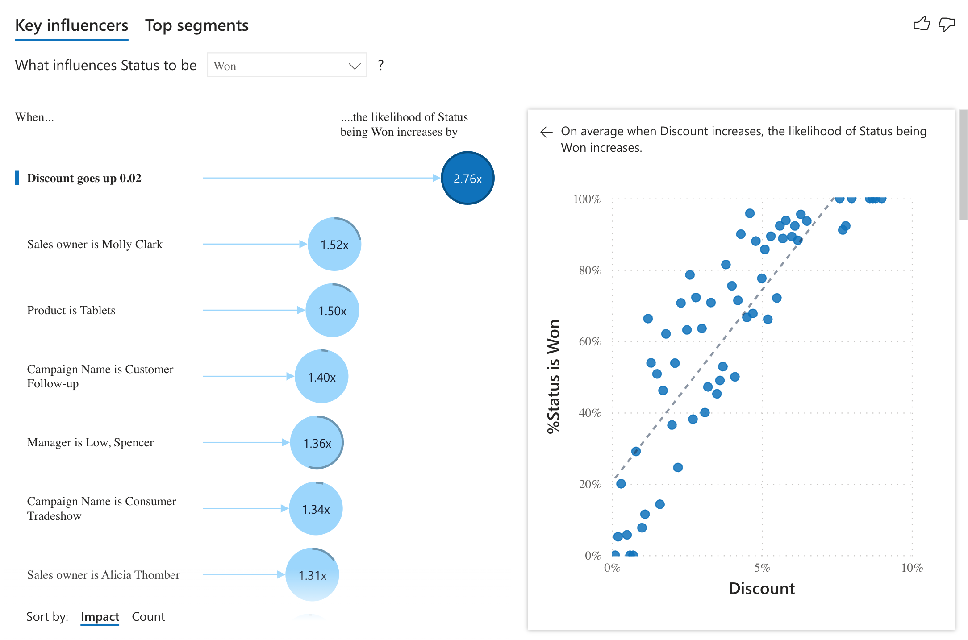
Key Influencer Visualization
It analyses the data based on the selected Key
Ranks the factors that matter and display them as key influencers.
Can also drill down into
Features

Slide 16
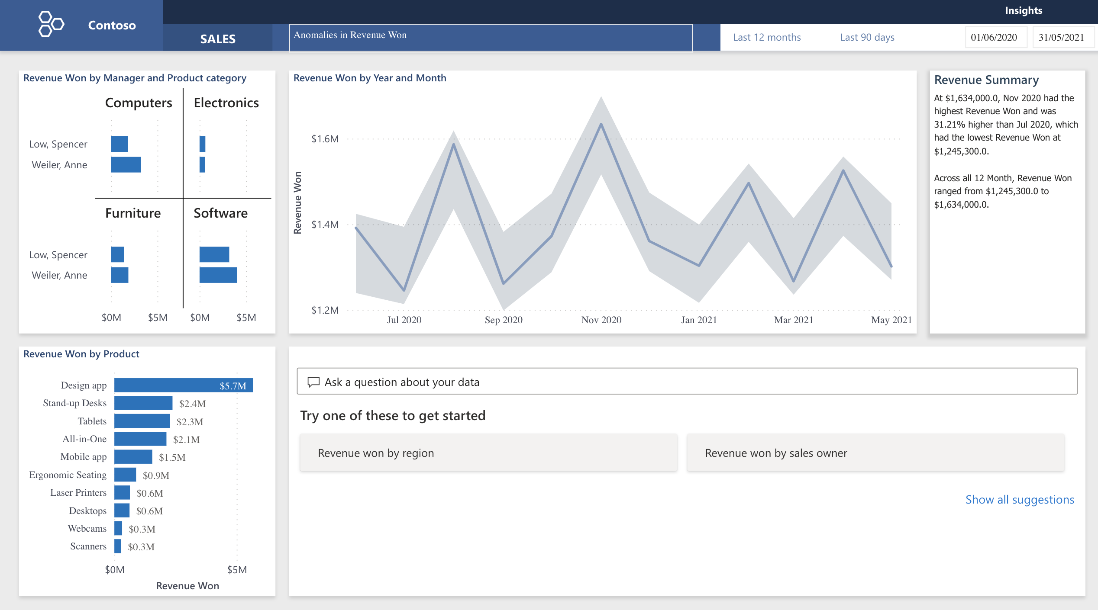

Slide 17
Machine Learning in Power BI

Slide 18
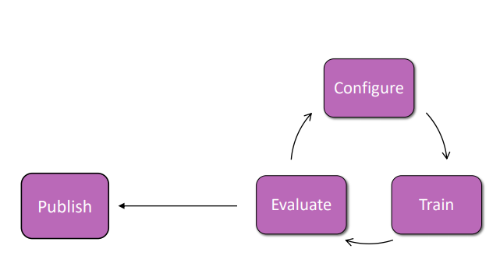
Power BI ML
Choose a model based on the business need
Configure your model
Train Model
Result vary depend on the configuration and data provided to train
Rapidly train and optimize decision making based on trend changes and feedback
Use context to rank options and make the best decisions
Evaluate (performance and quality)
Publish and Score Model

Slide 19
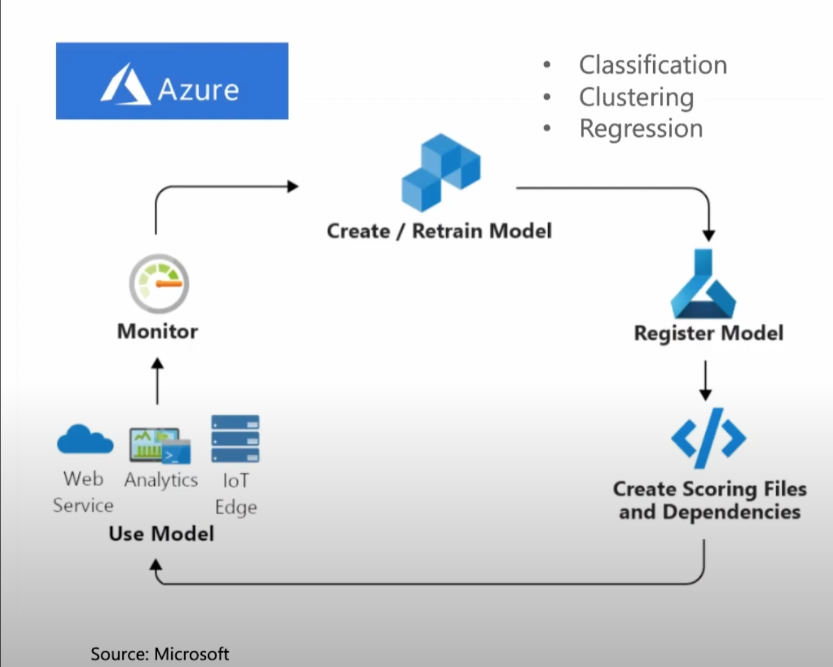

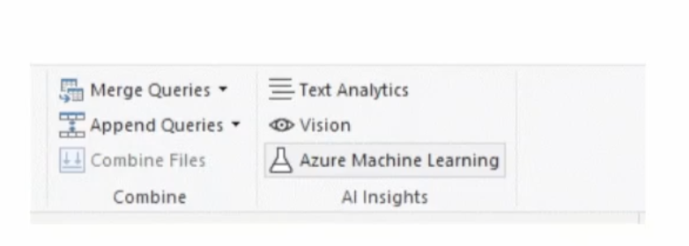

Slide 20
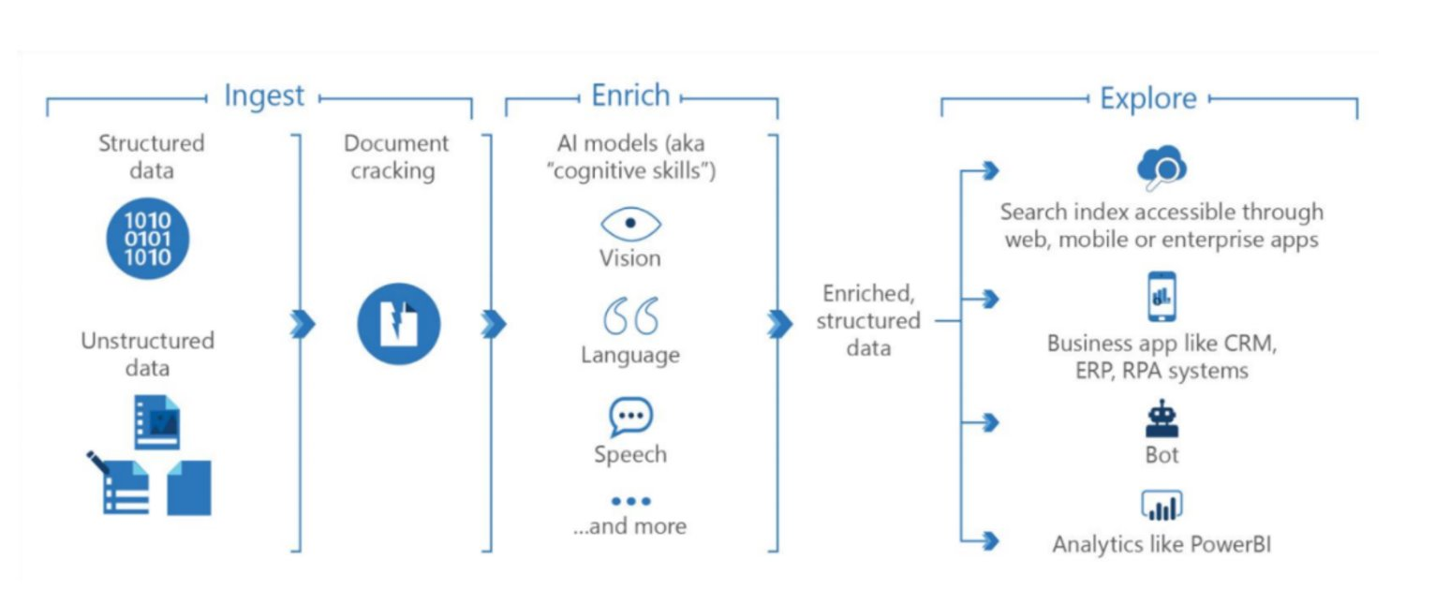
Knowledge Mining
Knowledge Mining orchestration steps (Source Microsoft)​
https://azure.microsoft.com/en-au/solutions/knowledge-mining/#solution-architectures​

Slide 21
Explore AI more
AI School: https://www.microsoft.com/en-us/ai/ai-school​
AI Lab: https://www.microsoft.com/en-us/ai/ai-lab​
https://docs.microsoft.com/en-us/training/modules/introduction-to-machine-learning/
https://docs.microsoft.com/en-au/power-bi/connect-data/service-tutorial-build-machine-learning-model
Transparency note for Semantic Analysis https://docs.microsoft.com/en-us/legal/cognitive-services/language-service/transparency-note-sentiment-analysis

Slide 22
“AI is here to empower People to be able do more with Technology”
Thank you!
Atlassian | @SomyAyazi | somy-ayazi​

